Slide 1
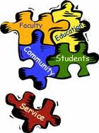
Literacy Ambassadors: Service Learning and Social Justice in L2 Classrooms
Rachael Cate, INTO Oregon State University

Slide 2
Reflection activity
Service learning and social justice theory
Scholarly research from service learning in international education
Indigenous learning communities’ literacy projects
Literacy ambassador model
Reflection and discussion

Slide 3
Reflection: What is Service Learning?
Who benefits from community service work?
What are some of your goals as a teacher?
What are some of your goals as a learner?
What are some qualities of the community do you hope to create for yourself and your students?

Slide 4
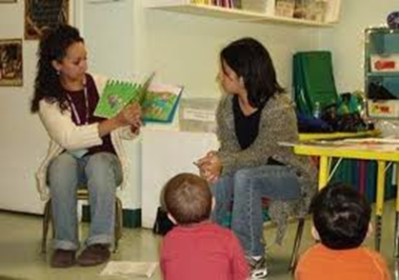
Synergy, Holism, and Diversity within Eco-social Organizations
Synergy: When multiple contributors collaborate to achieve mutual benefits --Fitjof Capra (1996)
Holism: The practice of seeing the “big picture” and finding solutions to problems with long-term and broad systematic outcomes in mind ---J.C. Smuts (1926)
Diversity: Variation within an integrated system that adds fresh perspectives, strength and adaptability to the system
---E.O. Wilson (1992)

Slide 5
John Dewey (1859-1952) The School and Society (1915)
Collaborative participation was key for Dewey in the “learning democracy” as “primarily a mode of associated living, of conjoint communicated experience” (quoted in Harbour& Ebie, 2011, p. 8).
According to Dewey, the motivation for cooperation and collaboration within communities of learning, which is a natural social organizing force based on group affinity and mutual goals, is thwarted by traditional competitive classroom environments, while it is encouraged by joint projects where successes are shared.
Dewey, John. The School and Society. Chicago, Ill: The University of Chicago press, 1915. Print.

Slide 6
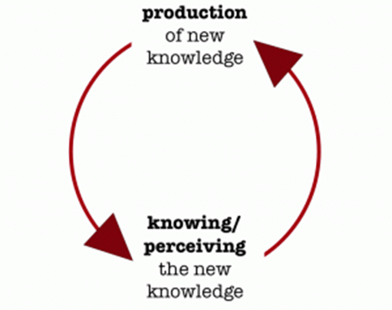
Paolo Freire (2000)
Education as both individual and community empowerment in collaborative voices and critical inquiry
Praxis: dialectical dynamic between action or engagement and analysis or reflection
Transformational learning: learning that engages with identity
Freire, Paulo. Pedagogy of the Oppressed. New York: Continuum, 2000. Print.

Slide 7
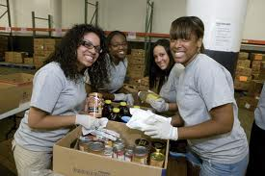
Service learning scholars: findings
Advantages:
authentic motivation for learning
project appropriateness/fit for particular communities
reciprocal/synergistic benefits of collaborative learning communities, and
the promotion of mutual learning interests
.

Slide 8
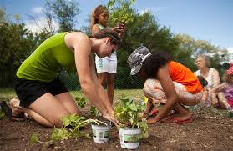
Service learning scholars: findings
Advantages of Cross-cultural Service Learning:
broadened worldview (Guenther & Miller, 2011, p. 12)
“self-concept, cultural awareness and appreciation, racial understanding, high post-graduation aspirations and readiness to work in diverse work environments” (Miller & Butler, 2011, p.21)
“collaboration, leadership and communication abilities” and “accelerating cultural & racial tolerance while reducing stereotypes” (O’Loughlin-Brooks & Smith, 2011, p. 70)
“sense of social responsibility, feelings of connection with their communities, tolerance for diversity, and cognitive moral development”( O’Loughlin-Brooks & Smith, 2011, p. 73)
.

Slide 9
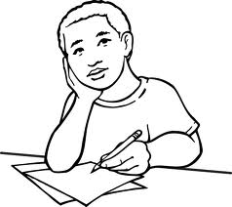
Ethnography, Participatory Action Research and International Service Learning Education
Pre-project exploration
Post-project assessment
Reflection and Praxis during all stages
(Barney, Kirk & Fife, 2011; Flower, 1997; Bridwell-Bowles, 1997; Bacon, 1997; Arca, 1997)
.

Slide 10
Indigenous Leaning Communities
Testimonios: I, Rigoberta Menchu (Menchú, 1984) and Let Me Speak (Barrios de Chungara, 1978) , learning projects in Latin America
self-initiated, auto-ethnographic transformational learning communities
creating spaces for counter-storytelling, critical border consciousness (Anzaldúa’s, 1999)
Synergistic, pervasive leadership and community-building by literacy ambassadors

Slide 11
Literacy Ambassador Service Learning Model
Ethnography/
Participatory Action for development, and reflection
Pervasive leadership: partnering with community leaders and capitalizing on prior knowledge
Offering credit for knowledge gained in real-world experience on students’ terms
Transformational Learning Communities and Community-building
Critical consciousness: space for questioning the status quo
.

Slide 12
Reflection
How might you empower your students to identify the shared values of their own communities?
And to identify literacy work that might enable them to become literacy ambassadors: to pursue learning goals for their communities that they identify themselves?
How might you ensure that critical reflection is tied to assessments of project learning outcomes?

Slide 13
Discussion: Would ESOL service learning be possible or valuable for your classroom?
Thank you!

Slide 14
Anzaldúa, G. (1999). Borderlands = La frontera. San Francisco: Aunt Lute Books. Barney, Steve T, Kirk, Rachel, & Fife, Boyd. (2011). Interdisciplinary international service learning: The story of our success. In R. L. Miller, E. Amsel, B. M. Kowalewski, B. C. Beins, K. D. Keith, & B. F. Peden (Eds.), Promoting Student Engagement. Volume 1: Programs, Techniques and Opportunities (Vol. 1, pp. 73–81). Society for the Teaching of Psychology. Retrieved from http://teachpsych.org/ebooks/pse2011/vol1/volume1.pdf Barrios de Chungara, D., & Viezzer, M. (1978). Let me speak! : Testimony of Domitila, a woman of the Bolivian mines. New York: Monthly Review Press. Capra, F. (1996). The web of life : a new scientific understanding of living systems. New York: Anchor Books. Dewey, J. (1990). The school and society ; and, The child and the curriculum. Chicago: University of Chicago Press. Freire, P. (2001). Pedagogy of the oppressed. New York: Continuum. Guenther, C., & Miller, R. L. (2011). Factors that promote engagement. In R. L. Miller, E. Amsel, B. M. Kowalewski, B. C. Beins, K. D. Keith, & B. F. Peden (Eds.), Promoting Student Engagement. Volume 1: Programs, Techniques and Opportunities (pp. 10–17). Society for the Teaching of Psychology. Retrieved from http://teachpsych.org/ebooks/pse2011/vol1/volume1.pdf Menchú, R. (1984). I, Rigoberta Menchú: an Indian woman in Guatemala. London: Verso. Miller, R. L., & Butler, Jeanne M. (2011). Outcomes associated with student engagement. In R. L. Miller, E. Amsel, B. M. Kowalewski, B. C. Beins, K. D. Keith, & B. F. Peden (Eds.), Promoting Student Engagement. Volume 1: Programs, Techniques and Opportunities (Vol. 1, pp. 18–23). Society for the Teaching of Psychology. Retrieved from http://teachpsych.org/ebooks/pse2011/vol1/volume1.pdf Smuts, J. C. (2006). Holism and evolution. [Whitefish, Mont.]: Kessinger Pub. Wilson, E. O. (1992). The diversity of life. New York: W.W. Norton.
References

