Slide 1
Empowering Adult Learners to Create Meaningful Texts and Personal Narratives in Literacy Classrooms
Eric Dodson, Margi Felix-Lund, Jen Sacklin
Fall Conference
October 12, 2013
Session 2.3
Notes:
NH 358
Introductions (personal).
Introduction (topic): this demo is focused on what teachers can do to involve leslla learners’ lives in the classroom. Specifically, we will focus on techniques for eliciting student narratives and other types of meaningful writing. Also, to be clear, this is a hands-on demonstration session, which means that we’ll ask everyone to participate in some small group activities that help demonstrate ways of eliciting learner text in classrooms.
The goal of this demonstration is for everyone here to leave this presentation w/ at least one concrete idea of how to get learners to talk about themselves in a meaningful way that can then be used to generate text for further classroom activities or materials.

Slide 2
Today’s Objectives
Identify unique characteristics and skills of emergent readers compared to mainstream ESL learners
Participate in an elicitation activity & reflect on how it relates to your teaching
Understand the how and why of a number of effective literacy activities
Take away resources for supporting literacy development

Slide 3
1 in 6 adults around the world are not literate in any language.
775.4 million adults worldwide in 2010
lacked basic reading and writing skills.
Source: http://www.uis.unesco.org/FactSheets/Documents/fs20-literacy-day-2012-en-v3.pdf

Slide 4
Of the world’s population of adult emergent readers,
64%
are women
Notes:
UNESCO Institute for Statistics, (2012). UIS fact sheet: Adult and youth literacy, September 2012, no.20. Retrieved from http://www.uis.unesco.org/FactSheets/Documents/fs20-literacy-day-2012-en-v3.pdf

Slide 5
Background
Learners with interrupted formal education come from a wide range of backgrounds — socially, culturally, linguistically, and in terms of their previous education — and it is a mistake to make any assumptions about what they have or have not experienced, or what they can or cannot do. However, it is still necessary to be able to recognize ESL literacy learners in order to provide them with the support they need to achieve their goals.
(Bow Valley, 2009)

Slide 6
Adult Emergent Readers
Come from various countries and cultural backgrounds
Have a range of educational backgrounds
May be in separate literacy tutoring groups or in integrated ESL classrooms
Come with extensive life skills, practices, and experiences

Slide 7
Including learners’ experiences as class content
Builds on learners’ strengths (Auerbach, 1995)
Learner-driven content is relevant (Tusting & Barton, 2003; Weinstein, 1999) and familiar: allows the class to spend more time on encoding meaning in text instead of puzzling out unfamiliar content (Freire, 1970)
Celebrates adult learners as people (Firth & Wagner, 1997; Lantolf & Pavlenko, 2001)
Enables rewarding relationships with students
Provides indirect needs assessment and classroom community building
Notes:
With that in mind, we’d like to spend some time discussing/reviewing some of the reasons for asking LESLLA learners to create their own stories in writing.
Familiarity
Builds on what ss already know
Brings context into class content
Makes class setting a more intelligible, less foreign place
Comprehension
Because of familiarity, comprehension and memory recall are less difficult
Benefits for: decoding skills, automaticity, reading fluency
Positive affect
Sharing narratives is a valued literacy practice
Relates directly to ss’ needs, experiences, and interests

Slide 8
Personal Narratives
Everyday
Anecdotes
Life
Histories
Spectrum of possibilities
Narratives can be:
Notes:
In this demo, we will focus on ways of using learner-generated texts, which is a powerful way of incorporating learners’ experiences, strengths, and meaningful content into the classroom. By learner-generated texts, we mean a range of writing that may range in topic, from personal narratives to something more descriptive and impersonal; the writing may be done based on the ss’ oral language, with the teacher writing the words down, it could be that the teacher corrects and facilitates the language, or not, or ss of certain levels may be able to write in small groups, pairs, or even by themselves.
For each of the activities we do today, we hope to give you a different perspective on the dynamics of writing activities for LESLLA classrooms, and after each activity, some time to share your thoughts and experiences.
The central example is students writing stories that narrate a life experience. For example, a teacher could work one-on-one with a student to help them write a story about their family, such as the birth of one of their children, or how they celebrated a certain holiday in their country.
Although learner narratives can be particularly powerful when teaching lessla learners, there are other types of writing that incorporate learners’ language in other ways. Almost any kind of descriptive writing could be a chance for the teacher to collaborate with learners in such a way that the learners feel that they created the text. For example, the task could be to describe a person in the learners’ family, an object in the room, or even the differences between their home culture and their current culture.
The other points listed show other continuum for learner-generated texts

Slide 9
Personal Narratives
Descriptive
Personal
Spectrum of possibilities
Topics can be:
Notes:
In this demo, we will focus on ways of using learner-generated texts, which is a powerful way of incorporating learners’ experiences, strengths, and meaningful content into the classroom. By learner-generated texts, we mean a range of writing that may range in topic, from personal narratives to something more descriptive and impersonal; the writing may be done based on the ss’ oral language, with the teacher writing the words down, it could be that the teacher corrects and facilitates the language, or not, or ss of certain levels may be able to write in small groups, pairs, or even by themselves.
For each of the activities we do today, we hope to give you a different perspective on the dynamics of writing activities for LESLLA classrooms, and after each activity, some time to share your thoughts and experiences.
The central example is students writing stories that narrate a life experience. For example, a teacher could work one-on-one with a student to help them write a story about their family, such as the birth of one of their children, or how they celebrated a certain holiday in their country.
Although learner narratives can be particularly powerful when teaching lessla learners, there are other types of writing that incorporate learners’ language in other ways. Almost any kind of descriptive writing could be a chance for the teacher to collaborate with learners in such a way that the learners feel that they created the text. For example, the task could be to describe a person in the learners’ family, an object in the room, or even the differences between their home culture and their current culture.
The other points listed show other continuum for learner-generated texts

Slide 10
Personal Narratives
Facilitator
Scribe
None
Spectrum of possibilities
The teacher’s role can be:
Notes:
In this demo, we will focus on ways of using learner-generated texts, which is a powerful way of incorporating learners’ experiences, strengths, and meaningful content into the classroom. By learner-generated texts, we mean a range of writing that may range in topic, from personal narratives to something more descriptive and impersonal; the writing may be done based on the ss’ oral language, with the teacher writing the words down, it could be that the teacher corrects and facilitates the language, or not, or ss of certain levels may be able to write in small groups, pairs, or even by themselves.
For each of the activities we do today, we hope to give you a different perspective on the dynamics of writing activities for LESLLA classrooms, and after each activity, some time to share your thoughts and experiences.
The central example is students writing stories that narrate a life experience. For example, a teacher could work one-on-one with a student to help them write a story about their family, such as the birth of one of their children, or how they celebrated a certain holiday in their country.
Although learner narratives can be particularly powerful when teaching lessla learners, there are other types of writing that incorporate learners’ language in other ways. Almost any kind of descriptive writing could be a chance for the teacher to collaborate with learners in such a way that the learners feel that they created the text. For example, the task could be to describe a person in the learners’ family, an object in the room, or even the differences between their home culture and their current culture.
The other points listed show other continuum for learner-generated texts

Slide 11
Personal Narratives
Small group
Pair
Individual
Spectrum of possibilities
Student groupings can be:
Notes:
In this demo, we will focus on ways of using learner-generated texts, which is a powerful way of incorporating learners’ experiences, strengths, and meaningful content into the classroom. By learner-generated texts, we mean a range of writing that may range in topic, from personal narratives to something more descriptive and impersonal; the writing may be done based on the ss’ oral language, with the teacher writing the words down, it could be that the teacher corrects and facilitates the language, or not, or ss of certain levels may be able to write in small groups, pairs, or even by themselves.
For each of the activities we do today, we hope to give you a different perspective on the dynamics of writing activities for LESLLA classrooms, and after each activity, some time to share your thoughts and experiences.
The central example is students writing stories that narrate a life experience. For example, a teacher could work one-on-one with a student to help them write a story about their family, such as the birth of one of their children, or how they celebrated a certain holiday in their country.
Although learner narratives can be particularly powerful when teaching lessla learners, there are other types of writing that incorporate learners’ language in other ways. Almost any kind of descriptive writing could be a chance for the teacher to collaborate with learners in such a way that the learners feel that they created the text. For example, the task could be to describe a person in the learners’ family, an object in the room, or even the differences between their home culture and their current culture.
The other points listed show other continuum for learner-generated texts

Slide 12
Eliciting Learner Narratives
Notes:
Thanks, Eric.
I’m going to take you through an activity that you can adapt for your classrooms to help learners tell you their stories. You can’t just say, “Tell me your story!”

Slide 13
Methods to elicit learner narratives
Share about yourself
Help learners get to know each other
Listen to and observe your students
Learners spontaneously tell you stories; run with them!
Put books out during break time
Bring in pictures or prompts
Scaffold their narratives
Notes:
· Share about yourself
o Modeling is always important!
o Helps to build classroom community by sharing personal info
o Gives Ss head’s up that we talk about ourselves in class (prior to asking for any info from them)
· Help learners get to know each other
o Encourage them to ask one another questions
· Listen to and observe your students
o teachers can learn more subtle information about students by simply paying attention: listening to side conversations, asking questions, and observing students in and out of class”
· Put books out during break time
o Thanks to Eric’s suggestion, I did this & it was an interesting way to see what Ss gravitated towards.
· Learners spontaneously tell you stories; run with them!
o Example of Cambodian student
· Bring in pictures or prompts
o Pictures of immigrants, refugees, or home cultures that Ss can relate to can provide a starting place for discussions that are not about the Ss’ personal lives
o Weinstein, 1999, p.25: in this example, the T brought in pics of Mien life in rural Laos & Ss were comfortable talking about the familiar pics, while they felt their own lives were rather depressing to discuss. The T reflected that the 1st person narrative may be culturally inappropriate (or at least less common) for her Ss. Ultimately, the Ss published a book on life in Laos that they were able to share with their children.
· Scaffold learner narratives
o Model oral language, then move to text, then provide paragraph schemas
· Use “shadow texts” (Morgan, 1997) for sensitive topics
o Learner-generated texts about other people in similar contexts are still valuable in that they are related to learners’ lives (although not personal)
o Ss could then have the option to expand stories to include personal accounts

Slide 14
Scaffolding learner narratives: Using a narrative schema
Notes:
Adapted from activity done by Diedre Cain, a PCC Cascade Level 1 teacher.
1-sheet activity, zoomed in for ease of reading on these slides. Here’s the 1st half:
This activity is appropriate for high-level emergent readers because it builds on what they already know (themselves), it provides scaffolding for both close- and open-ended sentences, and it gives the space for talking about literacy-focused ideas (e.g., what is a sentence? What is a paragraph?) as well as culture-focused ideas….

Slide 15
Scaffolding learner narratives: Using a narrative schema
Notes:
Adapted from activity done by Diedre Cain, a PCC Cascade Level 1 teacher.
1-sheet activity, zoomed in for ease of reading on these slides. Here’s the 1st half:
This activity is appropriate for high-level emergent readers because it builds on what they already know (themselves), it provides scaffolding for both close- and open-ended sentences, and it gives the space for talking about literacy-focused ideas (e.g., what is a sentence? What is a paragraph?) as well as culture-focused ideas….

Slide 16
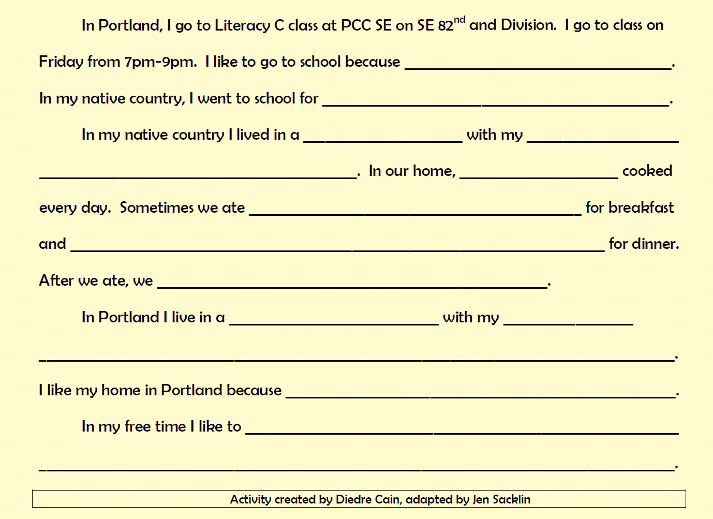
Scaffolding and entextualizing learner narratives
Notes:
Adapted from activity done by Diedre Cain, a PCC Cascade Level 1 teacher.
1-sheet activity, zoomed in for ease of reading on these slides. Here’s the 1st half:
This activity is appropriate for high-level emergent readers because it builds on what they already know (themselves), it provides scaffolding for both close- and open-ended sentences, and it gives the space for talking about literacy-focused ideas (e.g., what is a sentence? What is a paragraph?) as well as culture-focused ideas….
discussing things like sentences and paragraphs (for example, would it make sense to continue the second paragraph with, “Giraffes are cool animals.” ?? No? Why not? Have students talk about topic sentences and ideas, etc.

Slide 17
Notes:
Lots of modeling to start with!

Slide 18
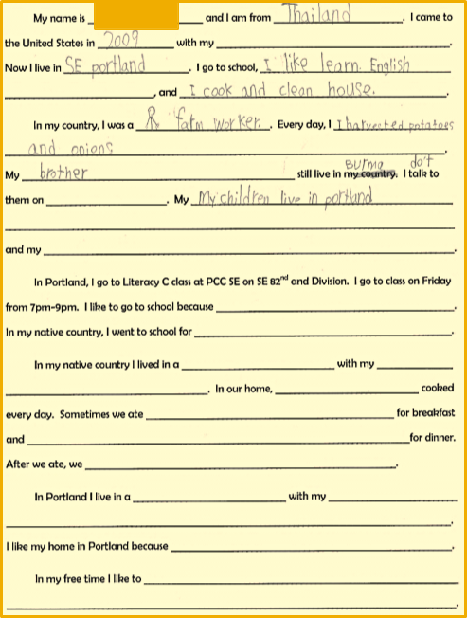
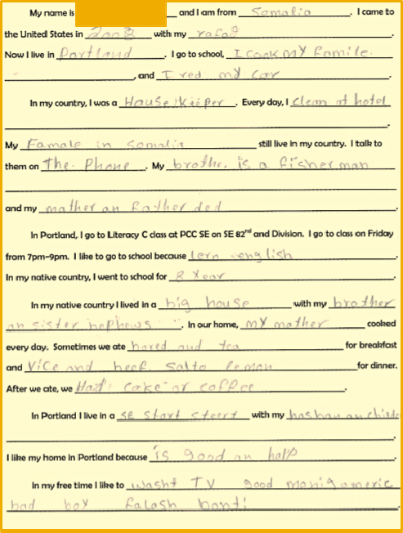
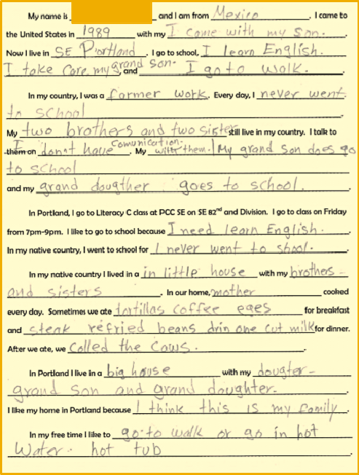
Notes:
Sample texts from learners: low, medium, high.

Slide 19
Critical second look
Asking for information on families can bring up tough memories
Narrowed identity options position learners only as immigrants (Baynham & Simpson, 2010; Miller, 2009)
However…
With trust and support, this activity can open avenues for students to express themselves
Extension activity: write a brand-new paragraph
Notes:
It is very difficult to elicit learner stories in a thoughtful way…. Just like in the example from the previous slide, asking for information on families can bring up tough memories.
Sometimes you might get learners experiencing a wave of emotion they can’t control
Learners might feel comfortable enough to share tough experiences with you, which then puts the burden on you to thoughtfully respond and engage

Slide 20
Activity: Narrative Schema
Oral language first: What does your work with emergent readers involve? – 1 min.
Individually fill out schema (handout p. 1) – 2 min.
Compare with a partner – 3 min.
find something in common
discuss how you might use a narrative schema in your classroom
Notes:
5 min. Jen intro.
1 min. participants can orally say what their work with emergent readers involves (only let 3 people talk)
2 min. individual write
3-6 min. compare with partner, and
5-7 min. debrief as a whole group.

Slide 21
Activity: Narrative Schema
Whole group – 5 min.
What makes this kind of activity work?
How is this activity different from an activity in a pre-made textbook?
How is this activity empowering and meaningful?
After helping learners generate these personal texts, how can use their texts in your classroom?
Notes:
6 min. debrief as a whole group (only let 5 people talk)
Value =
multilevel,
engages relevant and authentic language,
build it from oral language,

Slide 22
Using Learner-Generated Texts for Literacy Development

Slide 23
Balanced Literacy Instruction
Start with a familiar topic
relevant to learners’ lives
use oral language first
Once students are very familiar with the oral language, move to print:
“Whole” Activities: Focus on the meaning and/or whole words or phrases
“Part” Activities: where you take words or phrases that are meaningful to the students, and use them as the basis for developing:
phonemic awareness and phonics skills
focus on identifying and manipulating vowel sounds, consonant clusters, syllables, and rhyme
Notes:
Whole-Part-Whole is a balanced approach for teaching literacy. With this approach, you should start with a familiar topic that is relevant to learners’ lives. Discuss the topic and elicit vocabulary or phrases. Once students are very familiar with the oral language, move to print (this is the “Whole”). Top-down activities focus on meaning. After students are able to recognize and read the words, focus in on specific features. This is the “Part”, where you take words or phrases that are meaningful to the students, and use them as the basis for focusing on developing phonemic awareness and phonics skills. You might help students focus on vowel sounds, consonant clusters, syllables, and identifying rhyming words. Including these bottom-up activities in each class is very important, but they must be done in the context of familiar language. After focusing in on the parts of language, move back out to the “Whole” by continuing to discuss the topic. This approach can take time to master. All activities, Whole and Part, draw only from the language used in the learner-generated text. For more information, see Trupke-Bastidas & Poulos (2007) and Vinogradov (2010).
Phonemic awareness is a subset of phonological awareness in which listeners are able to hear, identify and manipulate phonemes, the smallest units of sound that can differentiate meaning.

Slide 24
Example of Whole-Part-Whole in Action
Elicit story
Can emerge from casual conversation
Discussed topic of work & school extensively
Each student supplied part of the story
Students generally familiar with vocabulary orally before moving to print
Notes:
Thematic unit: Jobs
Learner-generated Text: “We Work Hard”
Focus on whole story:& read discuss
Narrow focus down to the words
Phonics & phonemic awareness activities
Return focus to whole text

Slide 25
Notes:
Choral repetition

Slide 26
“Whole” Activities
Build understanding of oral language
corresponding to written language
Choral repetition
Pair reading
Silent reading
Reordering sentence strips
Copying
Tracing
Developing sight word vocabulary
Answering comprehension questions
Focus on everyone understanding the meaning of the text
Notes:
Once you have a student-generated text and you are certain that learners are familiar with the language in the story (orally), then you can begin the “top-down” activities. “Whole” reading activities keep the written language in context. The majority of a language lesson should focus on completing activities that are meaning-based. Depending on the structure of your class session, you may be able to lead your students in Whole-Part-Whole activities immediately after generating a text or you may prefer to create activities at home and use them the following session, or perhaps both.

Slide 27
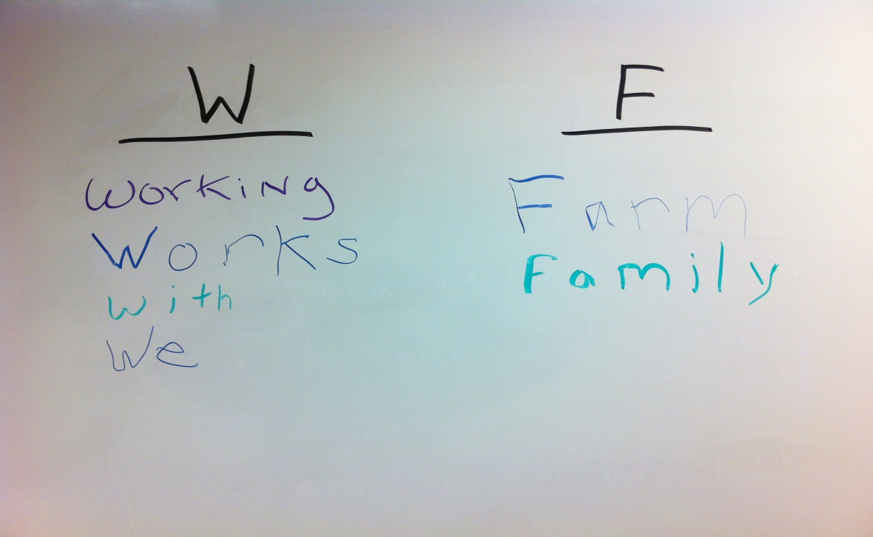
“Part” Activities
Build understanding of the “parts” of language that can be manipulated, verbally & in writing
After focusing on the language in context
help your students to “zoom in” and think about the parts that make up language.
should be used for brief periods of time during each literacy lesson
Sort words by the
same initial sound:
Notes:
Bottom-up activities should be used for brief periods of time during each literacy lesson. After focusing on the language in context, help your students to “zoom in” and think about the parts that make up language. These activities are very important for learners developing literacy. Return to the Whole after focusing in on the Part.

Slide 28
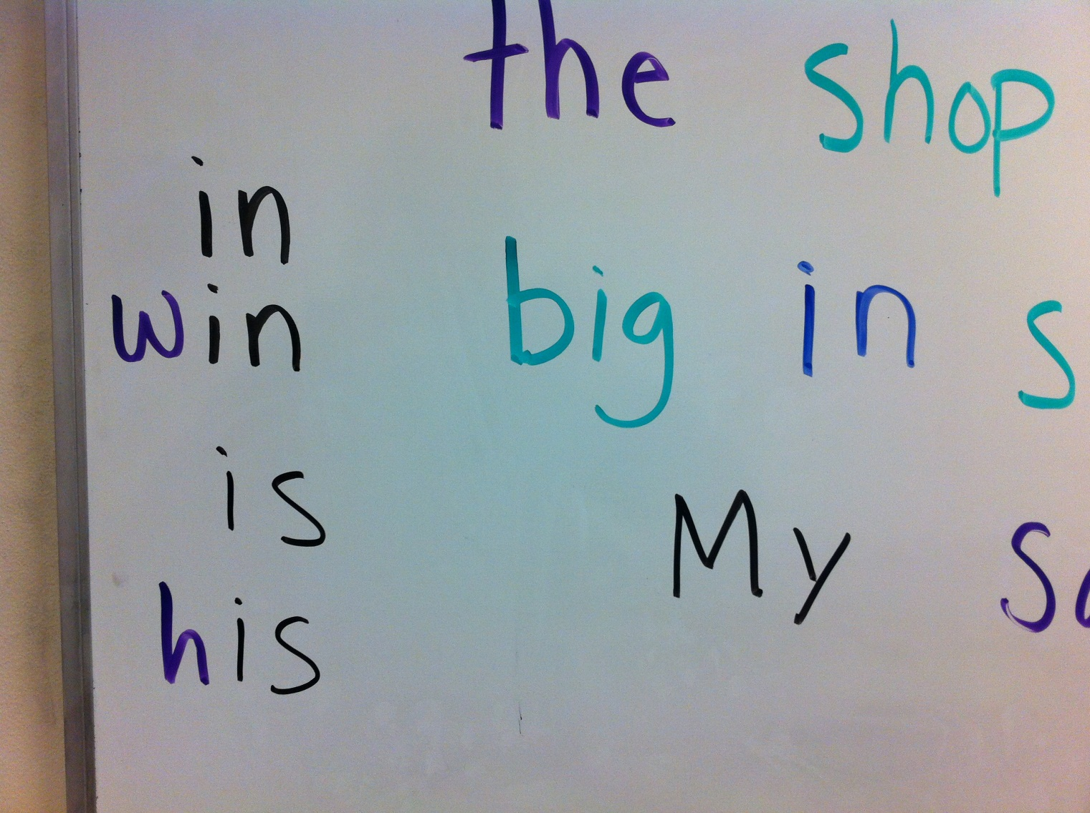
Phoneme Addition, Phoneme Segmentation & Count the Sounds
Notes:
Have students sound out words together and then ask them how it sounds when you add a new sound to it.
For a larger class, have students say the new word to a partner.
Ask students “how many sounds in this word” Explain the idea of sound and the difference between sound and letter.

Slide 29
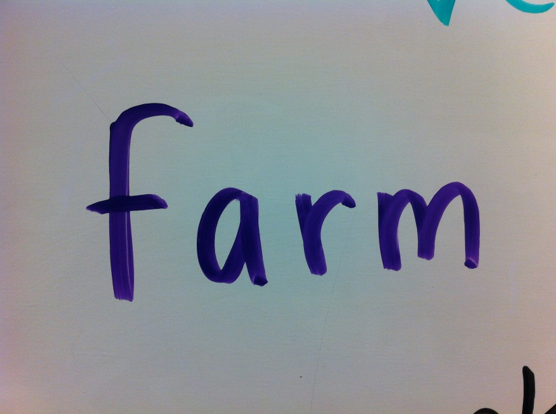
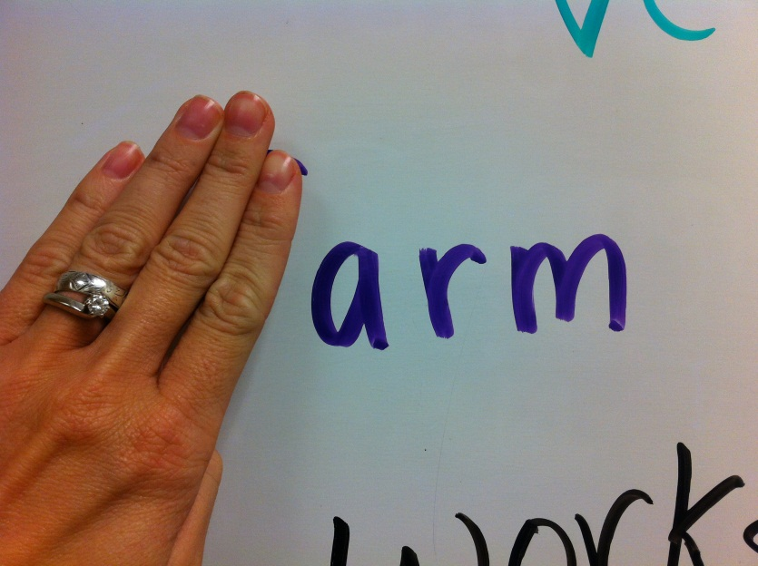
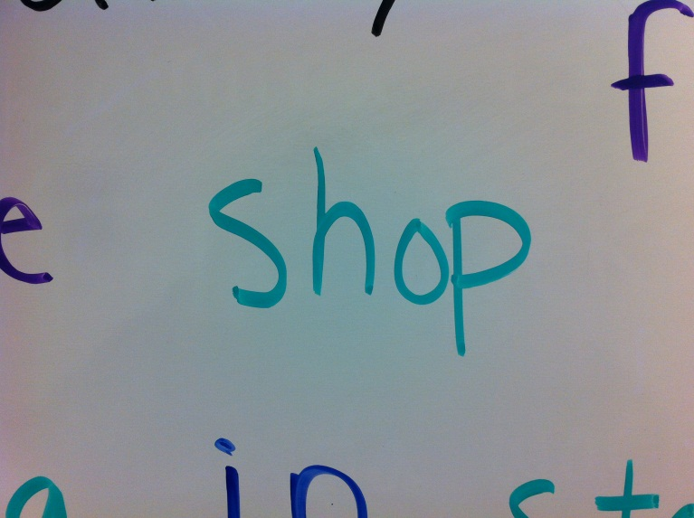
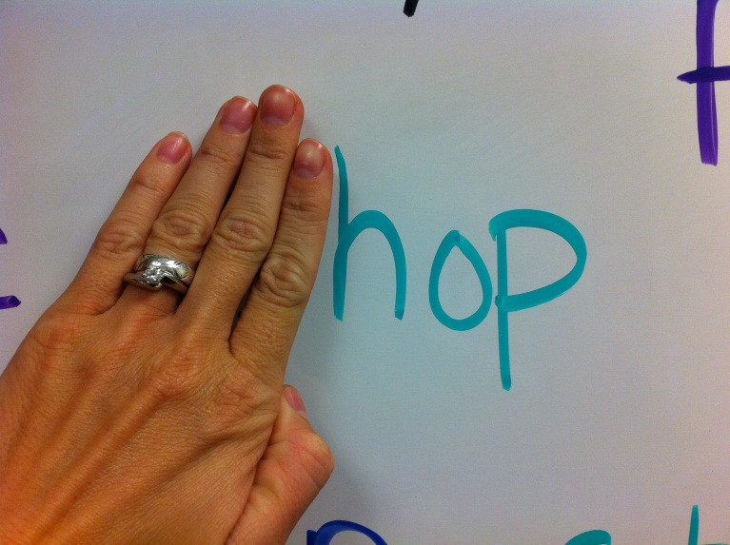
Phoneme Deletion and Substitution
Notes:
Help students build their phonemic awareness by asking them to recognize what word remains when a specified sound is removed: “what is ‘farm’ without the /f/?”

Slide 30
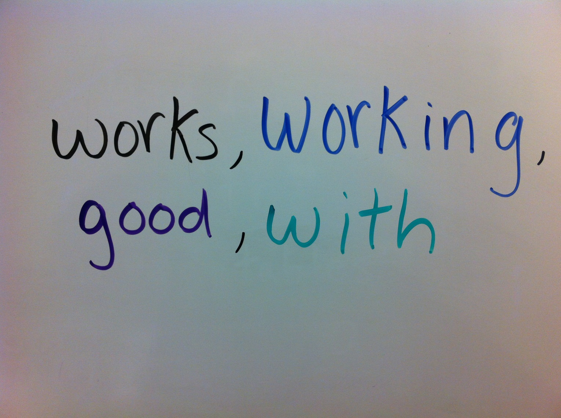
Phoneme Categorization
Which one is different?

Slide 31
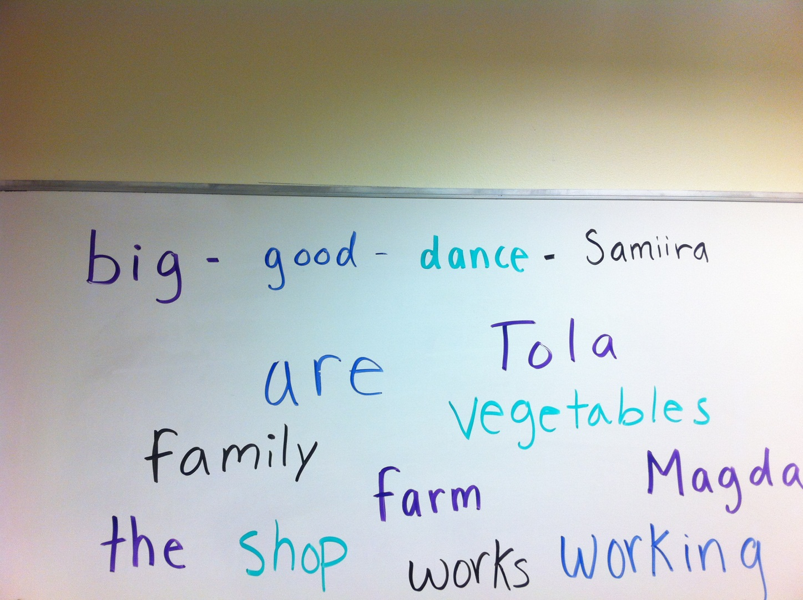
Phoneme Isolation: Sound Chain
Great for higher level students
Notes:
Recognizing individual sounds in words:
Sound chain- One student says a word that starts with end sound of other person’s word. We’re concerned here with SOUNDS, not spelling. This activity helps students focus attention on final sounds of words.
Ex: mom-married-dad-divorce-sister, etc…

Slide 32
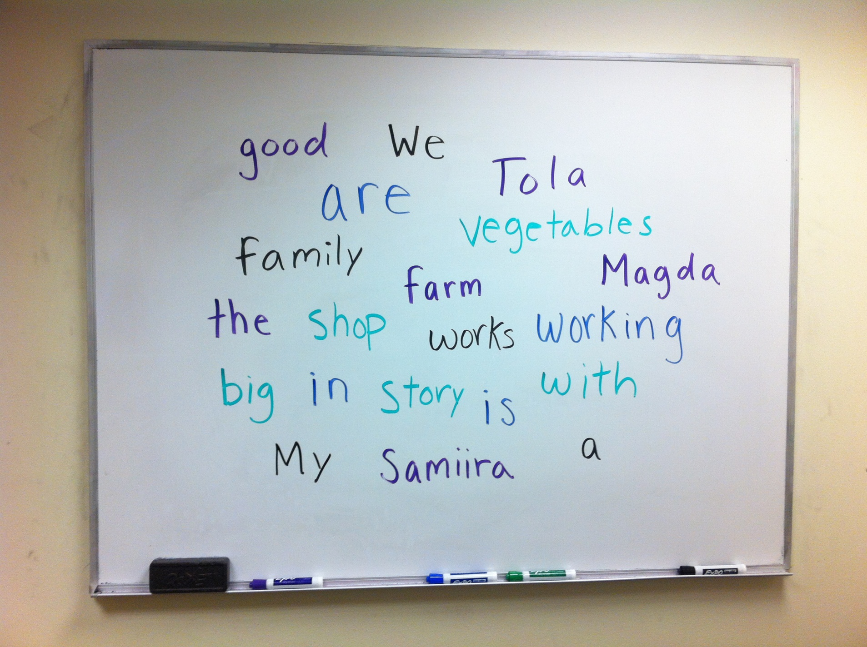
Sight Words
Notes:
http://www.newamericanhorizons.org/training-videos
(14:20-16:45)

Slide 33
Whole-Part-Whole
After briefly focusing on “Part”
15 minutes max for literacy students
Return to the “Whole” and focus on meaning
Partner reading
Revising story
Adding to story
Illustrating story
Notes:
When focusing on the parts of language, try a variety of activities, but make sure to help the learners establish a routine. If you find a couple of activities that work really well with your learners, continue using those activities as the content changes.
Remember the importance of balanced instruction. Don‘t spend too much time on phonemic awareness and phonics activities each week. It’s important to keep these activities as one small part of your total curriculum.

Slide 34
Extension
Notes:
I added a Flikr picture with a creative commons license to help give the printed story more context, in an iconic way.
Ironically, after eliciting this text with a group of three women from Somalia, the next week's class had five new learners. After some name and getting-to-know-you activities, we turned to this text, which ironically, over half the class had not seen before (so much for deep context). However, most of the new learners had similar life situations, including housekeeping work.
Furthermore, when others didn't understand something, the Somali women took a leading role in explaining -- for them, they cared that others were trying to read their story, and it was important that those others understood it. So, as a result of using a learner text, the Somali students were enabled/empowered (what is the word I am looking for here) to take on an expert role that they would not have likely otherwise engaged in.
My first approach, then, was top-down, raising awareness of schema present, such as the Name/Teacher/Room/Date information, the picture and its meaning, and the title. By asking questions about these schematic features, we were able to build a spoken base to begin with. I asked about the meaning of virtually every part, including the title. I followed up by asking "Do you know someone looking for a job?" in order to safely raise the topic.
Reading approach: T only x2; check comprehension; T only, ss follow with finger/pencil x2. Small "part" move: point to job, going, phone; how do you spell that? How many jobs are there? Only one? Two? Five? Check again: are there any new or strange words here?
T and ss read together 2-3x. Then, move to parts: What are the vowels? Write them down. Next to each vowel, write a word from the story that has that vowel. After 10 min, and as learners finish, have them share their answers on board. T reviews pronunciation, focusing on vowels, short/long.

Slide 35
Notes:
After the first lesson using this text, I gave the full word cloze as optional homework, to practice the vocabulary items. We used the same cloze in the beginning of the next class. For that 2nd class, I gave the vowel cloze as homework in order to raise awareness of spelling/pronunciation/vowels.

Slide 36
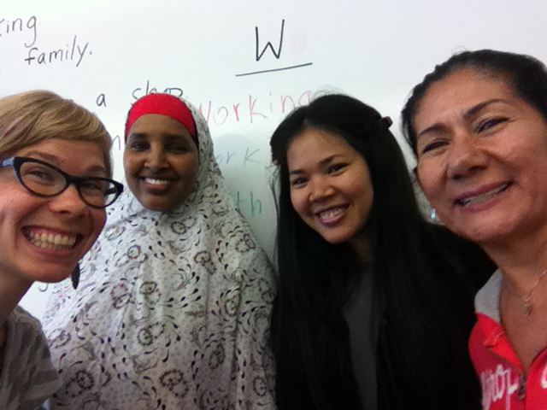
Major Benefits of Using Learner-Generated Texts in the Classroom
Learner-selected topics are relevant to their lives
Learners are familiar with the language
Many possible multi-level tasks
Learners will be proud to have written their own story!

Slide 37
Discussion
Thinking of the activities and information from today’s presentation, how do they relate to your classroom and students?
What activities have you found to be helpful for emergent readers? Why did they work?
Notes:
Question 3 side note- (especially in contrast to mainstream ESL classes where deficiencies of formal education and literacy skills are constantly brought to the forefront)

Slide 38
References
Auerbach, E. (1995). Deconstructing the discourse of strengths in family literacy. Journal of Reading Behavior, 27(4), 643-661.
Bow Valley College. (2009). Learning for LIFE: An ESL literacy handbook. Calgary: Bow Valley College. Retrieved from: http://www.esl-literacy.com/node/767
Firth, A. & Wagner, J. (1997). On discourse, communication, and (some) fundamental concepts in SLA Research. The Modern Language Journal, 81(3), 285-300.
Freire, P. (1970). Pedagogy of the oppressed. New York, NY: Continuum Press.
Lantolf, J.P. & Pavlenko, A. (2001). (S)econd (L)anguage (A)ctivity theory: Understanding second language learners as people. In M.P. Breen (Ed.), Learner contributions to language learning (pp. 141-158). Harlow, England: Longman.
Morgan, B. (1997). Identity and intonation: Linking dynamic processes in an ESL classroom. TESOL Quarterly, 31, 431–450.
Tusting, K. & Barton, D. (2003). Models of adult learning: A literature review. London: National Research and Development Centre for Adult Literacy and Numeracy.
Weinstein, G. (1999). Learners’ lives as curriculum, six journeys to immigrant literacy. Delta Systems and the Center for Applied Linguistics.

Slide 39
Thank you!
We would appreciate your feedback.
Slides, references, and resources are all available online.
Contact information:
Eric Dodson: eric.d.dodson@gmail.com
Margi Felix-Lund: margifelixlund@gmail.com
Jen Sacklin: jmsacklin@gmail.com
Feedback form: http://bit.ly/15rlNnQ

