Slide 1
Gearing Up for ELPA21
ORTESOL
November 15, 2014

Slide 2
ELPA21 Project Overview
Funded in September 2012 by the U.S. Department of Education
Initially awarded $6.3 million four-year Enhanced Assessment Grant
Purpose: To develop a summative online assessment and online screener to measure English language proficiency
Supplemental funding of approx. $2.7 million to support an accelerated timeline to delivery operational summative assessment in 2015-16
Fiscal Agent: Oregon Department of Education
Project Management Partner: Council of Chief State School Officers (CCSSO)
11 participating states

Slide 3
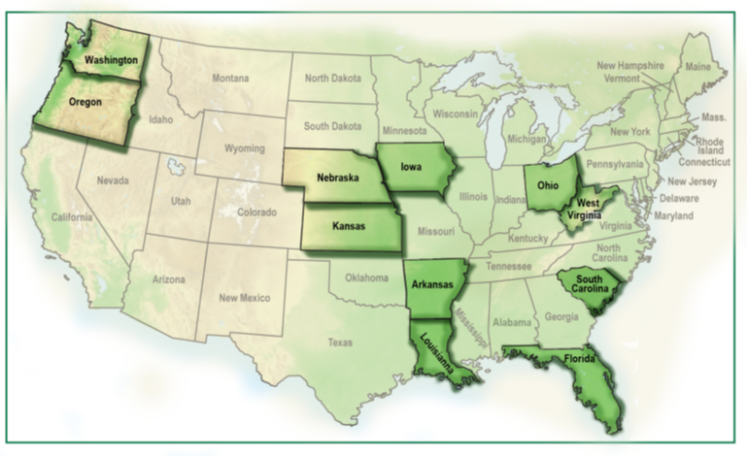
States Working Together in Partnership with National Experts
ELPA21 is a multi-state consortium developing an English language proficiency assessment system
Collaborating with:
Understanding Language Initiative (Stanford University) – Dr. Kenji Hakuta, Principal Investigator
National Center for Research on Evaluation, Standards, and Student Testing (CRESST) – Technical Advisory Committee leads
National Center on Educational Outcomes (NCEO) of the University of Minnesota – Dr. Martha Thurlow, Lead, Accessibility & Accommodations TMT
Council of Chief State School Officers (CCSSO) – project management partner
Notes:
ELPA21 is a consortium of 11 states working in partnership with national EL and test development experts to develop an assessment system designed to measure the performance of English language learners (ELLs) as they progress through their K-12 education and achieve college and career readiness.
The ELPA21 assessment will measure student proficiency in the new English Language Proficiency (ELP) Standards that correspond to academic content standards in English language arts, mathematics, and science, and will report on the four language domains (reading, writing, speaking, and listening).

Slide 4
Milestones
2013
2014
2015
2016
2017
Summative Assessment Becomes Operational
(Jan. – March 2016*)
ELP Standards Adopted
(Oct. 2013)
Cognitive Labs
(Fall 2014)
Item Development
(May 2014 – Jan. 2015*)
Field Test
(Feb.-March 2015)
Screener Becomes Operational
(August 2016)
*Dates are approximate.
Notes:
Over the past three years Oregon has been a very active governing state in the Smarter Balanced consortium. We have learned a tremendous amount about being in a well functioning consortium. Our transition to the content area assessments will occur abruptly.
Cognitive labs for item types and pilot test delivery features (Fall 2014)
Field Test (Window: Feb. – March 2015)
Operational Summative Assessment (Window: Jan. -March 2016 )
Operational Screener Assessment (Window: August 2016 – June 2017)

Slide 5
Gearing Up for the Platform & System Trial and the Field Test
 | Platform and System Trial (Pilot) | Field Test
Goals | Small scale technical trial of the ELPA21 Field Test Platform Tests both the administrative (setup/scheduling) and the test delivery systems Trial run to ensure that all aspects of the user experience run smoothly, that directions and documentation are clear, that students are able to move between and within items as intended, and that platform tools are functioning properly. Field test platform will be refined using feedback from platform and system trial. | Large scale test of ELPA21 items. Test ELPA21 items functionality across various student populations. Item performance data from the field test will be used to construct the ELPA21 summative and screener assessments.

Slide 6
Gearing Up for the Platform & System Trial and the Field Test
 | Platform and System Trial (Pilot) | Field Test
Participants | All ELPA21 States Test Administrators, SEA staff, LEA staff, students | All ELPA21 States Districts/Schools – ultimately students
Participation | Smaller scale (capped participation) | Large scale (unlimited participation) (But there are target populations/demographics.)
Registration Window | Open Now! | Open Now! Second round of Recruitment: Early November, after Questar’s gap analysis
Testing Period | January 6-14, 2015 | February 2 - end of March 2015 Rolling opening of testing window: Grades 9-12 window opens Feb. 2 Other grade bands window opens Feb. 16

Slide 7
Student Groups in the Field Test
Current ELL
Students who receive ELL services and have not yet reached proficiency sufficient for program exit
Former ELL
Students who have tested proficient in the past two academic years and are being monitored
Screened but English Proficient
Students deemed proficient through administration of the ELL screener
English Only
Students whose Home Language Survey results indicated they are not potential ELLs, or students whose only language is English

Slide 8
Number of Schools Registered by State (as of Oct. 20, 2014)
 |  | Test Option
State | Total N | Pilot & FT | FT Only
Arkansas | 106 | 59 | 44
Iowa | 65 | 46 | 15
Kansas | 134 | 30 | 93
Nebraska | 54 | 16 | 35
Ohio | 15 | 9 | 6
Oregon | 52 | 11 | 31
Washington | 85 | 5 | 79
West Virginia | 73 | 42 | 21
Total Number of Schools | 584 | 218 | 324

Slide 9
Registered Schools with English-Only Students (Oct. 20, 2014) Note: Count is number of schools.
 |  | Non-ELL Participation
State | Total N | Yes | No
Arkansas | 103 | 32 | 71
Iowa | 61 | 32 | 29
Kansas | 123 | 36 | 87
Nebraska | 51 | 17 | 34
Ohio | 15 | 8 | 7
Oregon | 42 | 10 | 32
Washington | 84 | 24 | 60
West Virginia | 63 | 45 | 18
Total | 542 | 204 | 338
Notes:
Question in Survey:
Q : In addition to the ELLs, we are interested in having English-only students participate in the field test. Would you provide a sample of students (approximately 10% of your total sample) whose home language survey result in not potential ELL, or student whose only language is English?

Slide 10
Current ELLs* and Student Registration Status** by State (Oct. 20, 2014) *Based on 2010-11 data. **Not including English-Only group.
State | ELL* | Target | Registered for Field Test | % of Target
Arkansas | 32,743 | 14,734 | 2,373 | 16.1%
Iowa | 21,415 | 9,637 | 1,681 | 17.4%
Kansas | 43,454 | 19,554 | 3,896 | 19.9%
Nebraska | 20,548 | 9,247 | 1,452 | 15.7%
Ohio | 38,312 | 17,240 | 257 | 1.5%
Oregon | 62,403 | 28,081 | 2,095 | 7.5%
Washington | 98,467 | 44,310 | 12,363 | 27.9%
West Virginia | 1,727 | 777 | 406 | 52.2%
Total | 319,069 | 143,581 | 24,523 | 17.1%

Slide 11
Student Registration Status by Grade Band – All ELPA21 States Combined (Oct. 20, 2014)
 |  |  | Registration Status
Grade Band | Target | Total N (% of Target) | Current ELL | Former ELL | Screened but English Proficient
K | 24,000 | 1,340 (5.6%) | 1,107 | 6 | 227
1 | 24,000 | 1,576 (6.6%) | 1,355 | 18 | 203
2-3 | 24,000 | 3,477 (14.5%) | 2,869 | 249 | 359
3-5 | 24,000 | 3,672 (15.3%) | 2,847 | 393 | 432
6-8 | 24,000 | 5,861 (24.4%) | 3,865 | 900 | 1,096
9-12 | 24,000 | 8,957 (37.3%) | 4,508 | 1,354 | 2,735
Total | 144,000 | 24,883 (17.3%) | 16,551 | 2,920 | 5,052

Slide 12
Student Registration Status by Grade Band: Oregon (Oct. 20, 2014)
 |  |  |  | Registration Status
State | Grade Band | Oregon Target | Total N | Current ELL | Former ELL | Screened but English Proficient
Oregon | K | TBD | 71 | 65 | 0 | 6
 | 1 |  | 101 | 94 | 4 | 3
 | 2-3 |  | 216 | 200 | 13 | 3
 | 4-5 |  | 165 | 119 | 44 | 2
 | 6-8 |  | 926 | 475 | 345 | 106
 | 9-12 |  | 616 | 225 | 322 | 69
 | Total |  | 2,095 | 1,178 | 728 | 189

Slide 13
Register for the Field Test Today!
By including the widest possible array of students, we will ensure that the new assessment is better tailored to accurately assess the needs of all of our ELs.
Sufficient Oregon participation will ensure that the Field Test results reflect the diversity of Oregon’s EL population.
Students and teachers who participate will have a unique opportunity to see and experience the new assessment firsthand, without worrying about scores.
ELPA21 offers flexible participation in and administration of the Field Test — consider signing up your entire class or even the whole grade to streamline scheduling.
Oregon incentives for participation to be announced soon.
If you haven't registered your school or district for the ELPA21 Field Test and Platform and System Trial, you can do so today at https://elpa21ft.questarai.com/registration/

Slide 14
Questions re: the Field Test
ELPA21 website for the Field Test: http://www.elpa21.org/fieldtest
Email inquiries re: the ELPA21 Field Test: ode.elpa21fieldtest@state.or.us
ODE Contacts
Martha Martinez, Education Specialist, ODE Office of Learning – Education Equity
ELPA21 involvement: Consortium Council; Performance Standard Setting, Data and Reporting Team martha.martinez@state.or.us
(503)947-5778
Michelle McCoy, Education Specialist, ODE
Office of Learning – Assessment & Accountability
ELPA21 involvement: Item Acquisition & Development Team; Field Test & Technology Team
michelle.mccoy@state.or.us
(503)947-5829

