Slide 1

A STUDENT CENTERED APPROACH TO WORKING WITH ENGLISH
LANGUAGE
LEARNERS
Ewa Chomka-Campbell M.Ed.
ORTESOL 2014
Notes:
SCB 102- 45 mins
Let’s take a A 35 000 ft view

Slide 2
Cultural Values
Culture…
Some cultures have specific vocabulary embedded in their values for inclusive, student centered education…
    NZ Maori

Slide 3
Culture
effective and reciprocal teaching and learning relationships where everyone is a learner and a teacher (ako)
  the care for students as culturally located people above all else (manaakitanga)
the care by teachers for the academic success and performance of their students (mana motuhake)
  the nurturing of mutually respectful and collaborative relationships between all parties around student learning (Whakawhanaungatanga)

Slide 4
What’s the difference?
Research…
STUDENT CENTERED
variety of different types of methods
instructors are facilitators
teaching objectives are the development of learner capacity and intelligence
emphasizes original thinking, connecting, individual needs, diverse experiences.
  Hara 1995 Blumberg 2008
TEACHER CENTERED
teacher’s role is to present the information that is to be learned and to direct the learning process of students.
Shuell (1996)
the teacher identifies the lesson objectives and takes the primary responsibility for guiding the instruction by explanation of the information and modeling.
Bannon (2002)

Slide 5
Research…
“Analysis of outcomes for students at all
four study schools confirms that they are
out-performing most other schools in their respective communities that are serving similar populations, especially African American, Latino, low-income students, and English language learners. This is evident in graduation, student achievement, and college preparatory course completion data; college persistence data; and surveys of graduates”.
(Friedlaender, D., Burns, D.,Lewis-Charp, H., Cook-Harvey,C.M., Darling-Hammond, L. “Student-Centered Schools: Closing the Opportunity Gap” (2014), ii). The Stanford Center for Opportunity Policy (SCOPE)
Notes:
Recent research shows that a student centered approach is good for kids.

Slide 6
Student Centered…
Research…
Connections
Leadership
Collaboration
Curriculum
Pedagogy
Personalization
Instructional Supports
Assessments
SCOPE Stanford 2014
Notes:
All four schools had all 8 components in place - But for these also need to be in place for kids to be successful.

Slide 7
Many different names for this approach…
Approach…
Active Learning (Bonwell & Eison, 1991)
    Collaborative Learning (Bruffee, 1984)
Inquiry-based Learning
Cooperative Learning (Johnson, Johnson, & Smith, 1991)
Problem-based Learning
Peer Led Team Learning (Tien, Roth, & Kampmeier, 2001)
Team-based Learning (Michaelson, Knight, & Fink, 2004)
Peer Instruction (Mazur, 1997)
Inquiry Guided Learning
Just-in-Time Teaching
Small Group Learning
Project-based Learning
Question-directed Instruction
Notes:
----- Meeting Notes (10/18/14 07:13) -----
We are all familiar with these approaches to learning but how many of us apply these daily to enhance or support instruction and learning?

Slide 8
SHIFT HAPPENs
Notes:
Well, we know that historically major changes in education do occur and Shift happens.
----- Meeting Notes (6/25/13 06:58) -----
And as a part of the educational community we know that shift happens

Slide 9
LEARNER
Research…
Learner Development
Learner Differences
Learning Environment
Oregon Teacher Evaluation Standards 2014
Notes:
Now we are being asked to focus on the learner. First – we are also being asked to focus on the learner
----- Meeting Notes (6/25/13 06:58) -----
And a national shift in rhetoric

Slide 10
Research…
Notes:
And we are being asked to focus on deep skill development

Slide 11
Research…
‘ELLs benefit from instructional approaches that treat language and content in an integrated way that is designed to help them build the language skills that they need to succeed in content classrooms, college and careers.’
Stanford 2014
Notes:
We also know that ELLs benefit from
F

Slide 12
Integrated Studies
Research…
‘… innovations and best practices for combining multiple academic subjects to prepare students for a world where all knowledge is integrate.’
Edutopia.com
Notes:
And research tell us that an integrated approach is

Slide 13
‘…. creating environments where all students set goals and understand what they need to achieve to reach them.’
Research…
OEIB 2014
Notes:
And that by creating the optimal environments for students they can be successful.

Slide 14
ESOL Instructional Shifts
Research…
Then…
Now…
Separate
Solo planning
Solo teaching
ESL classroom
Language isolated
Language use limited
Integrated
Co-planning
Co-teaching
ESL/Core classroom
Language in context
Language in Action
Notes:
Which means We are asked to shift our focus and our mindset about how we work, who we work with, and why.
Co-Teaching = Collaborative Teaching

Slide 15
Research…
“Students learn by and are most engaged in learning when they are DOING things and CONNECT learning to real world experiences…”
(Lombardi 2007)
Notes:
We also know that…..
Example of Esther – Brave.

Slide 16
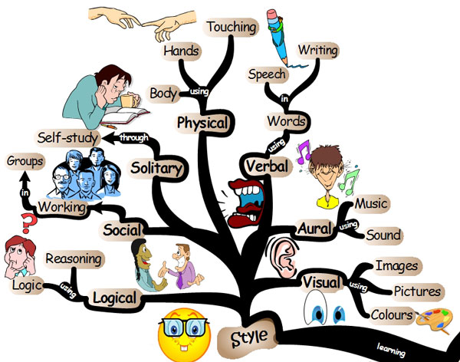
Learning differences
Research…
Notes:
Learning differences and experiential differences. Where are the spaces and tools to meet the needs of all these learners?

Slide 17
Research…
Notes:
And that It takes approximately 5-7 years to reach native, advanced, grade level English language proficiency

Slide 18
Student Centered Language Instruction
Research…
Open-ended problem solving requiring critical and creative thinking
Role-playing and participation in simulated situations
Non-traditional writing assignments
Collaborative team projects
Individual, self-paced assignments
Community engagement and Service-Learning assignments
Notes:
Our instruction needs to be focused on

Slide 19

Application
Thinking Hat
Notes:
So I put onmy thinking hat because I had to do things differently

Slide 20
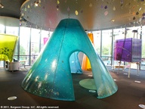



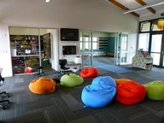
New Classrooms
Application
Inclusive
Uninterrupted
Specialized to meet the needs of its diverse student body
Relevant & Connected
Global to meet the need of the digital native students
Individualized
Notes:
Focused on creating new classrooms

Slide 21
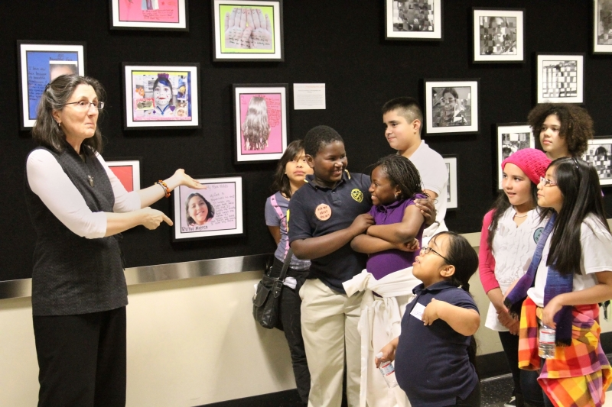
Authentic
Application…
Listen/Read (Receptive)
Speak/Write (Productive)
Illocutionary/Urban Language development (Interactive)
Global Communication (multi/mono-lingual)
Performance proficiency based (standards)
Notes:
On providing authentic learning opportunities

Slide 22
Notes:
Using sensory, graphic and interactive supports

Slide 23
Application…
Notes:
So the first thing I did was design a new lesson planning template – one that captured all that good research and best practice
And then I attended all school grade level PLC meetings to find out what each grade was learning

Slide 24
Project-Based Learning
Research…
A dynamic classroom approach in which students actively explore real-world problems and challenges and acquire a deeper knowledge.
Edutopia.com
Notes:
I chose one specific student centered approach and focused on supporting and developing projects that my kids were doing or could do that would integrate ELD and Content

Slide 25
Find out what’s going on…
Application…
Attend Grade level PLC meetings
Know the ELA, MATH, SCIENCE and SOCIAL STUDIES curricular and text
Know the focus in electives and integration of electives with core classes (art, reading, music)
Know what strategies the school and teachers use to teach reading and writing
Know your CCSS, NGSS, and ELPS
Know how to design, facilitate, and assess performance based learning
Etc …..
Notes:
Know what your school is doing

Slide 26
Application…
DESIGN THE PROJECT
Notes:
I use a project design template

Slide 27
Know your students…
What do you like to make or do?
Application…
Make a peanut butter sandwich
Play Bingo
Play field hockey
Read about Romans
I like sewing
I like to ski
Informative/Explanatory
Argument/Opinion
Narrative
Notes:
Know your students - Using visuals students identified what they liked to do or what they liked to make

Slide 28
Know & Understand: Think & Talk
Application…
How do we do those things?
Anchor Standards

Slide 29
Apply & Analyze: Research
(fiction/non-fiction text + digital
Application…
Find fiction and non fiction texts describing or focused on how to do things or how to play something.
Daily 5
  Read to yourself
  Read to/with someone
  Work on Writing
  Listen to Reading
  Spelling & Word Work
    GROUPING
Anchor Standards

Slide 30
Apply & Create: Let’s Find Words
Application…
What special words help you make or do your favorite thing?
Let’s Make Rubrics -
Notes:
Develop rubrics with help of students
Vocabulary development
Read other directions around same topics
Use internet to explore the task
Find words Intro students to thesaurus

Slide 31
Create & Evaluate: Let’s Write
Application…
6 Traits
  Idea (oral brainstorm, clustering + synthesis, theme)
  Organize (sequencing & text reference)
  Voice (fiction/non fiction story or directions/tell)
  Word choice (S+1)
  Sentence Fluency (alliteration, assonance, variety, simple/compound)
  Conventions (spelling, capitals, singular/plural, periods, ?, !, complete sentence, paragraphing, proof reading)
  Presentation (self, peer, family)

Slide 32
Evaluate & Create: Share & Present
Application…
Share with Teacher
Share with Family
Share with Principal
Publish on Blog
Print & Publish
Display in hallway
…..

Slide 33
Problem Based-Learning Questions
Application…
What challenges did Native Americans face that remain today ?
Who should control the rain forest?
What was Thomas Jefferson's greatest achievement and how does it influence contemporary society or politics today?
What issues should be considered before food is genetically altered?
How can buildings be wired to maximize efficiency?
In designing and building the Wall of China what challenges would you face?*
Notes:
Ways to tie Language learning to Content thru integrated projects
Examples of how educators can structure learning for language learners. Through essential questions such as……and put language learners into situations that enable them to LEARN USE and APPLY language.

Slide 34
Products
Cartoons (Political cartoons)*
Song lyrics*
Outlines*
Visual graphics*
Drawings*
Graffiti Wall Art*
Diagrams*
Sports Commentary*
Notes:
Some products samples students can generate

Slide 35
Products
Interviews*
Play scripts*
Newspaper articles*
Advertisements*
Spreadsheets*
Historic documents*
Letters to the editor/President*

Slide 36
Products
Comparison chart*
Free-form map*
Flowchart*
Analogy in any form*
Picture*
Comic strip*
Art Journal entries*

Slide 37
Products
Persuasive letter*
Venn diagram*
Foldable booklet*
Flip chart*
Painting*
Mural*
Lesson plan*

Slide 38
Products
Pilot TV Show*
Itinerary*
Travel guide*
Floor plan*
Tapestry
Bulletin board*
Weather forecast*

Slide 39
Products
Quilt*
Performance*
Crossword puzzle*
Game*
Illustrated Time Line*
Recipe*
Menu*

Slide 40
Products
Reports/written summaries*
Multimedia presentation*
Digital video*
Obituary*
Community News*
Warm Up America*

Slide 41
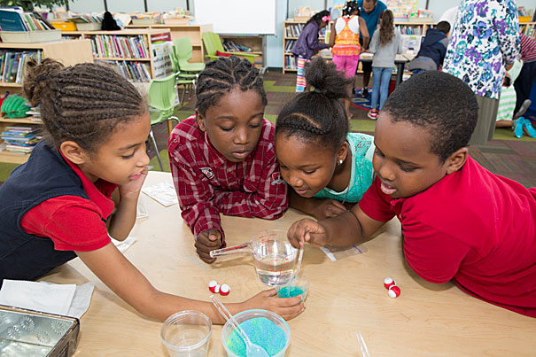
Tell me and I forget,
Teach me and I remember, Involve me and I will learn
Benjamin Franklin, 1750
Notes:
So the message seems to be if you tell me I’ll forget. If you teach me I may remember but If you involve me I will learn.

Slide 42
Service Learning
Research…
Student Centered Learning…
… boosts civic and community engagement in students and helps them take initiative to strengthen their learning and community.

Slide 43
World Peace Who's In Charge?

Slide 44
Ewa Chomka Campbell M.Ed.
Equal Access To Education www.equalaccesstoeducation.com ewacampbell@me.com
303-513-0760

